Slide 1
Pager Rotation Duties
Puna Poudel

Slide 2
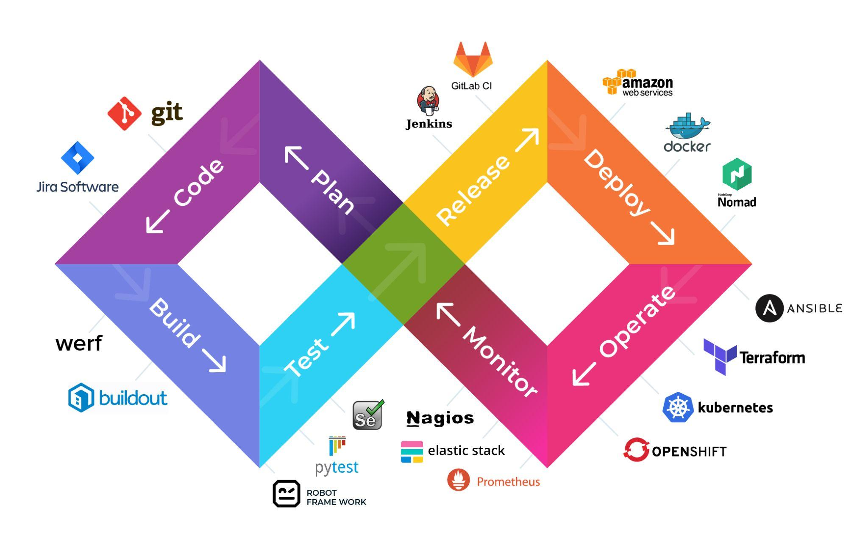
Introduction to Pager Rotation Duties
In the DevOps model, pager rotation duties involve scheduling team members to be on-call for incident response, ensuring system reliability and swift issue resolution.

Slide 3
SWOT Analysis
Weaknesses
Opportunities
Can lead to burnout, requires strong automation, and may cause alert fatigue if not managed well.
Enhances team collaboration, allows for continuous learning, and improves incident handling efficiency.
W
S
O
T
Strengths
Threats
Improves system reliability, ensures quick incident response, and promotes shared responsibility.
Poorly managed rotations can decrease morale, impact work-life balance, and lead to high turnover rates.

Slide 4




Importance of Pager Rotation Duties
Improves Incident Resolution
Enhances Collaboration
Prevents Burnout
Ensures System Reliability
Encourages shared responsibility between development and operations teams,
Distributes on-call duties fairly, ensuring no single team member is overburdened.
Structured rotations ensure accountability and faster troubleshooting.
Maintains continuous monitoring and rapid response to incidents, minimizing downtime.

Slide 5
Define Clear Roles and Responsibilities
01
Ensure everyone knows their role when on-call.
Best Practices for Managing Pager Rotation
Establish Escalation Policies
02
Outline steps for escalating incidents to avoid prolonged downtime.
Automate Alerts and Monitoring
03
Keeping Systems Reliable, Teams Balanced, and Stress Low.
Reduce false positives with intelligent alerting systems.
Set Fair and Balanced Rotations
04
Avoid overburdening specific team members.
Review and Improve Processes Regularly
05
Continuously analyze rotation effectiveness and make necessary adjustments.

Slide 6
Automating Incident Response
01
Implement tools like PagerDuty, Opsgenie, or VictorOps for efficient alerting and scheduling.
02
Use AI-driven monitoring to filter out unnecessary alerts and prioritize critical ones.
03
Ensure proper logging and incident documentation to streamline future responses.

Slide 7
Strategies for Reducing On-Call Fatigue
01
Implement a follow-the-sun model for distributed teams to balance workload across time zones.
02
Allow shift swapping for better flexibility and personal time management.
03
Use post-incident reviews to identify common issues and prevent repeat alerts.

Slide 8
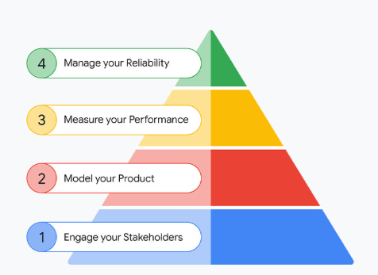
Pager Rotation Case Study - Google SRE
01
Google Site Reliability Engineering (SRE) emphasizes blameless postmortems to learn from incidents.
02
They leverage automation and runbooks to reduce the cognitive load on on-call engineers.
03
Their approach to balanced on-call shifts has helped maintain service reliability while improving engineer well-being.

Slide 9



Challenges in Pager Rotation & How to Address Them
Delayed Incident Resolution
Burnout Risk
High Alert Noise
Automate triage processes and use structured escalation paths.
Set up fair rotations and encourage cross-training to spread knowledge.
Implement better monitoring tools and fine-tune alert thresholds.

Slide 10
Conclusion
01
Pager rotation enhances system reliability and minimizes downtime.
02
Fair scheduling prevents burnout and promotes a balanced workload.
03
Automation and structured escalation improve response efficiency.
04
Continuous learning through postmortems strengthens future incident handling.

Slide 11
References
Incident.io. (n.d.). Best practices for creating a reliable on-call rotation. Retrieved February 3, 2025, from https://incident.io/hubs/on-call/on-call-rotation-best-practices
PagerDuty. (n.d.). On-call rotations and schedules. Retrieved February 3, 2025, from https://www.pagerduty.com/resources/learn/call-rotations-schedules
OnPage. (n.d.). Guide to facilitating equitable on-call rotations. Retrieved February 3, 2025, from https://www.onpage.com/guide-to-facilitating-equitable-on-call-rotations
Squadcast. (n.d.). A detailed guide to setting up effective on-call rotations. Retrieved February 3, 2025, from https://www.squadcast.com/blog/a-detailed-guide-to-setting-up-effective-on-call-rotations

Slide 12

Thank You !!
Any Questions?
Drop a mail at
prpoudel@my365.bellevue.edu

